Slide 1
Ground Station and
Satellite Tracking System
A Western CubeSat Project
Notes:
Introduction of self and our project title

Slide 2

The Project
Notes:
Talk about cubesat project, Western has received a 200k grant to develop 2 microsatellites which will be used for LEO imagery of the earth. The project is doing concurrent designs with UHF and S-band communications which are two radio frequencies with different directional capabilities, blah blah blah.

Slide 3

Problem statement
Problem
Statement
To design and build a functional satellite tracking ground station
Westen’s CubeSat Project lacks an accessible ground system that can maintain communication with the satellite
Notes:
Annie
The problem statement is that the we need to design this fucntion satellite tracking ground station, motivation is that the western cubesat team needs one to complete their research as the GS will be the connection point between the cubesat in orbit and the mission control team on the ground.

Slide 4
Existing Ground Station Designs
Stationary and unidirectional systems
Do not align with satellite and achieve uplink only when the satellite passes overhead
Fixed and cannot be relocated to other areas
Extremely expensive

Slide 5
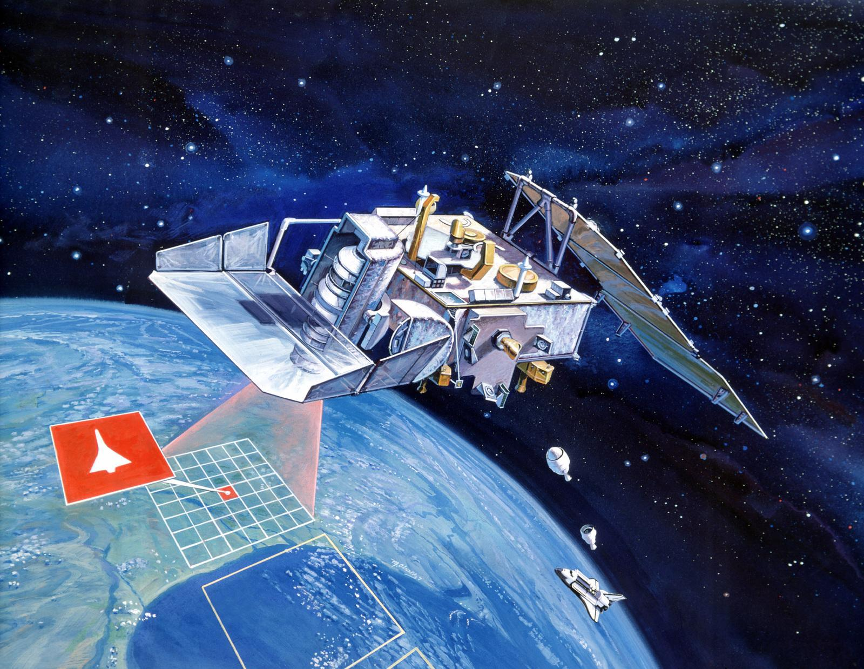
What customers do today
Project
Scope
Designing the physical ground station
Designing and implementing a satellite tracking algorithm Designing control system

Slide 6
Concept Generation
Three main physical design components
Base
Rigid. Stable. Transportable.
Azimuth Subsystem
Compact. Accurate. Low Cost.
Elevation Subsystem
High Torque. Accurate. Low Cost.

Slide 7
Selected Concept
Truss base and square metal pole
Thrust and radial bearings for azimuth motor
160:1 gearbox for elevation motor
Stepper motor and encoder for dual accuracy

Slide 8
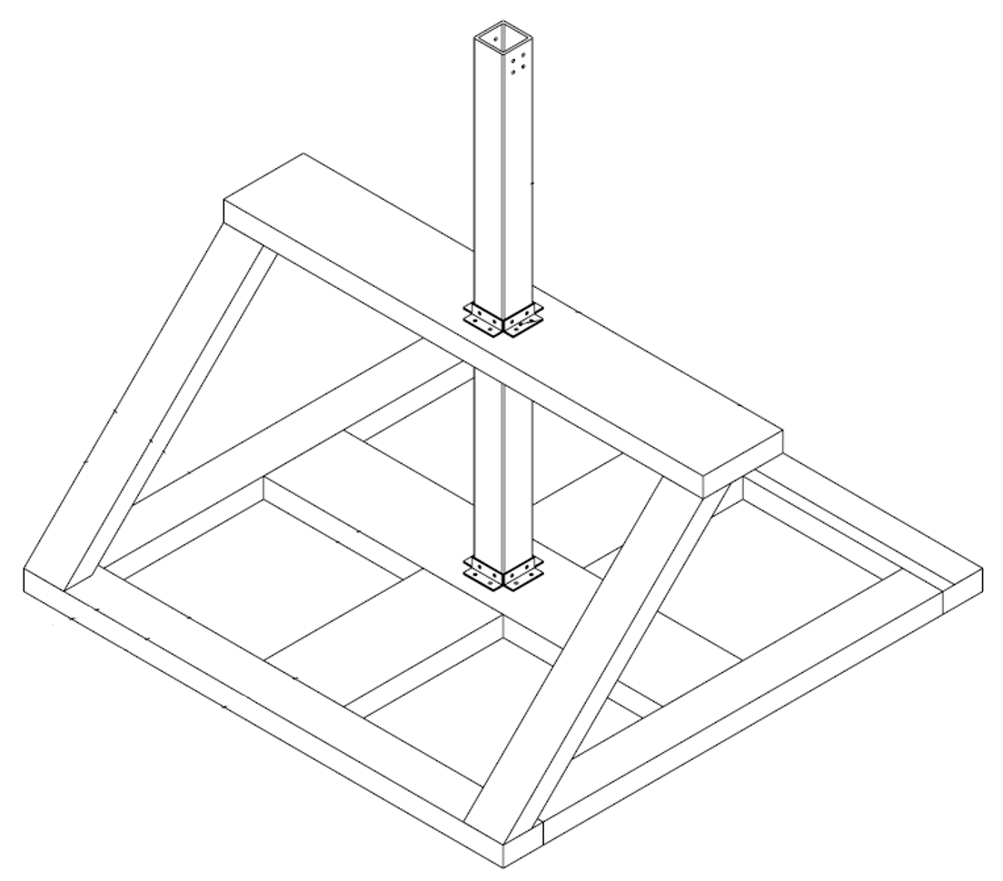
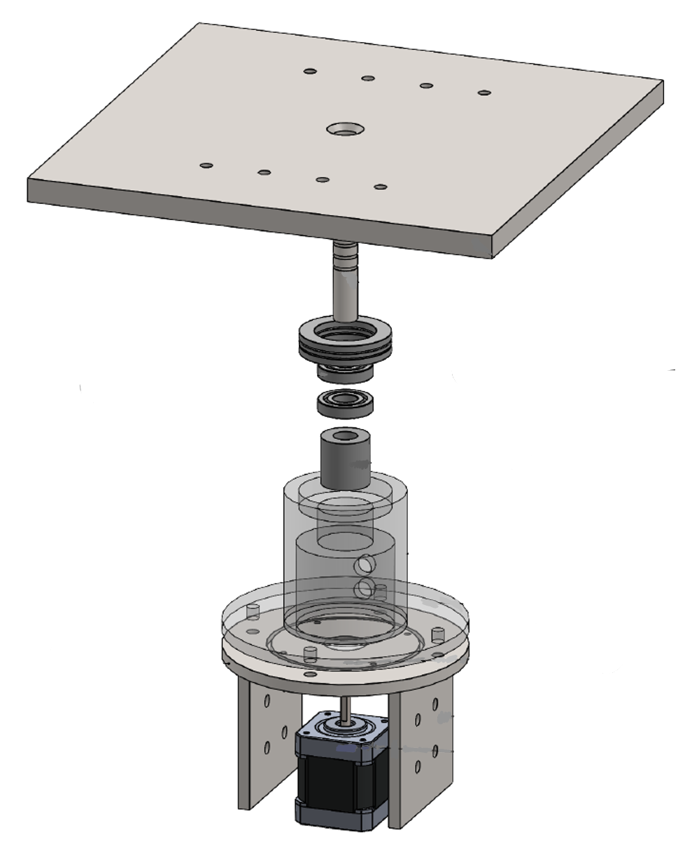
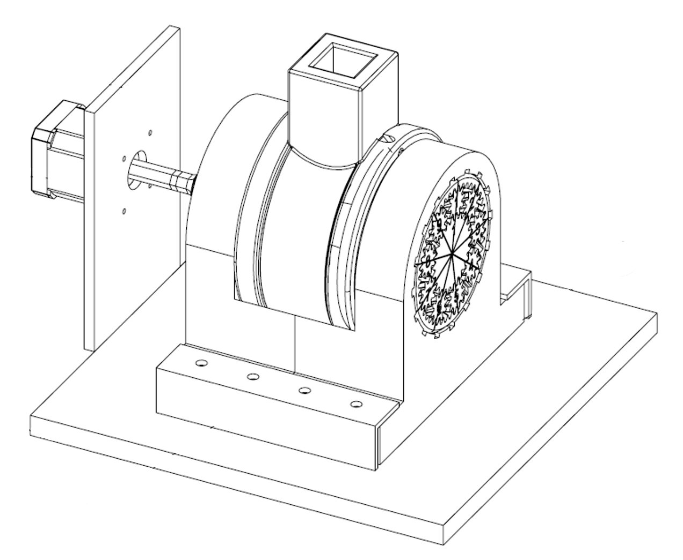
Selected Concept

Slide 9
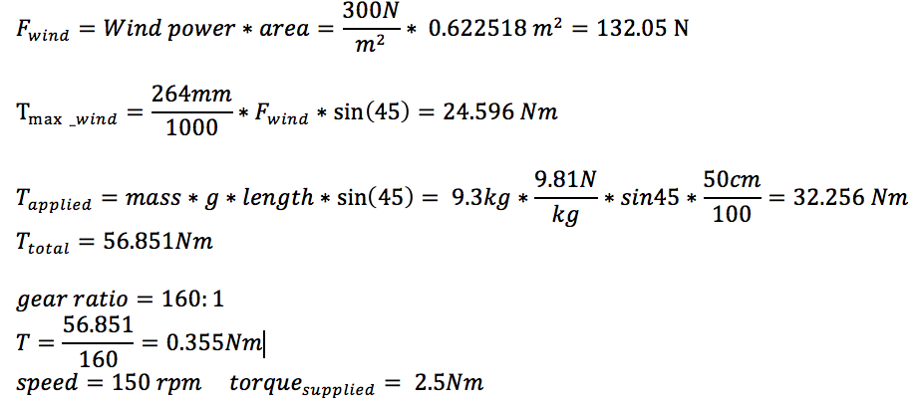
Torque Calculations
0.6Nm

Slide 10


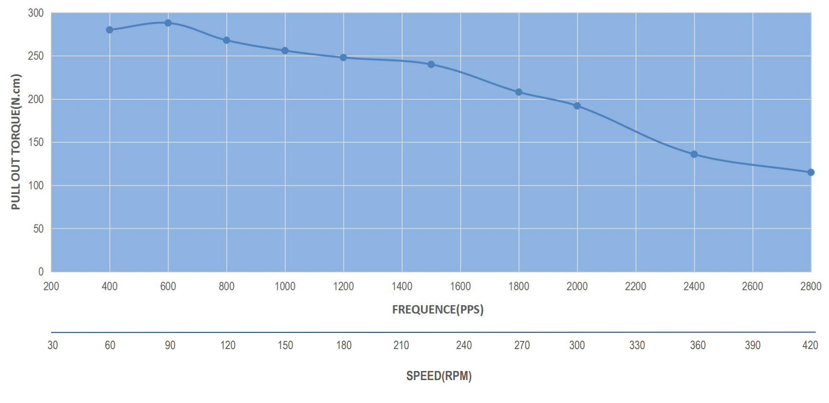
Torque Calculations
~

Slide 11
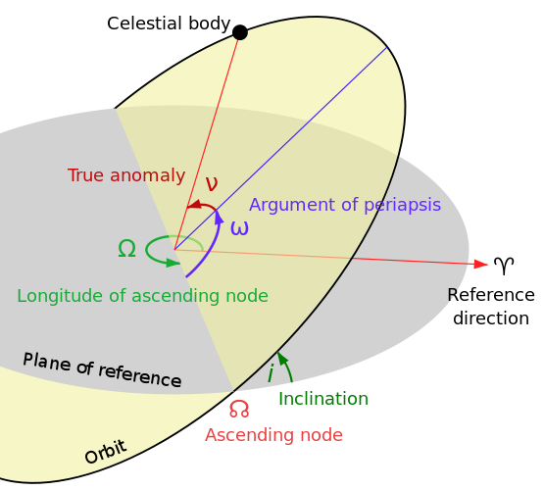
Software
Initial position
Communication with CubeSat
Wait for CubeSat
Time, satellite parameters
SGP4 or SGP8 prediction model
Get next overhead time and location
Set the angle of antennae
Notes:
flow

Slide 12
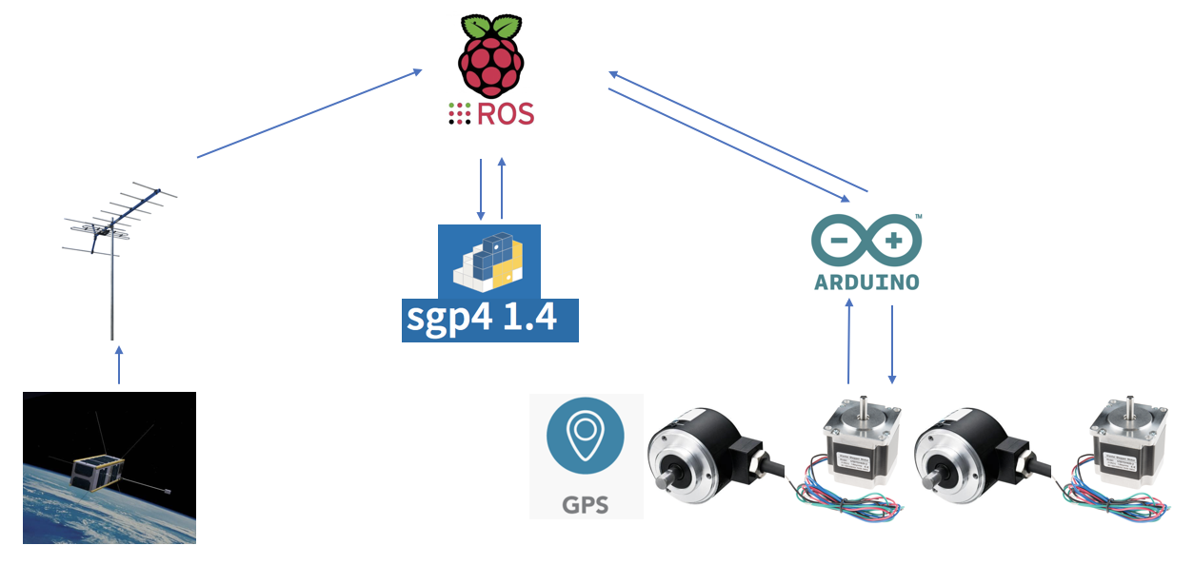
System Architecture

Slide 13
Demonstration

Slide 14
Problems Encountered
Sizing issues with the 3D printed gearbox
Power conversion and distribution
Encoder connection
Shaft alignment due to welding
Desynchronization of ROS

Slide 15
Future Considerations
Creating the outer box using the weatherproofed wood
Create housing for exposed elevation motor
Resin print parts of the gearbox to ensure better fit

Slide 16
Questions?

